Slide 1
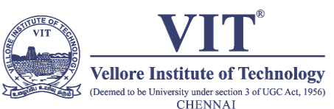

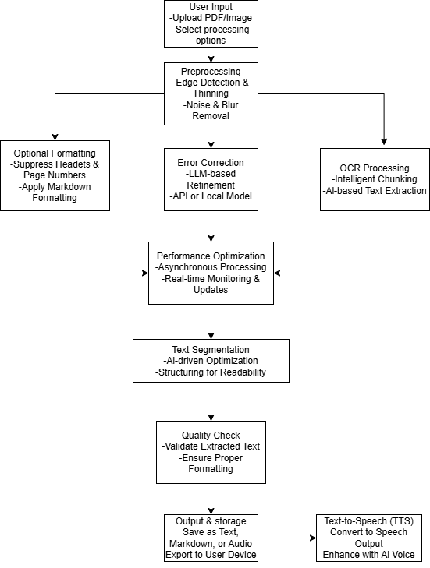
AI-Enhanced OCR System with LLM Integration for Accurate Text Recognition and Accessibility
Omprakash P - 21BCE1950, Jayan Anderson - 21BRS1506, SK Hari Prasat - 21BCE1245
Dr. Sudharson S
School of Computer Science and Engineering
MOTIVATION / INTRODUCTION
Traditional OCR systems like Tesseract struggle with complex document layouts, poor-quality scans, and handwritten text, leading to frequent errors.
Manual proofreading is time-consuming and impractical for large-scale document processing. Additionally, existing OCR tools lack built-in accessibility features for visually impaired users.
To address these challenges, this project integrates Large Language Models (LLMs) with OCR technology to enhance text recognition accuracy, automate error correction, and provide text-to-speech (TTS) functionality for accessibility.
This innovation bridges gaps in digitization text recognition, context-aware correction and multilingual support, addressing these limitations for legal, academic, and visually impaired users.
OBJECTIVES
To develop an LLM-aided OCR system that improves text recognition accuracy and processing speed. To study advanced feature extraction methods for error correction.
To compare the performance of LLM-enhanced OCR with traditional OCR systems.
To enable real-time processing and contextual error correction and provide an open-source alternative to proprietary OCR tools.
Process to implement a novel integration of text-to-speech technology for visually impaired users.
SCOPE OF THE PROJECT
The scope of this project is to assist healthcare professionals, researchers, and visually impaired users in accurately extracting text from scanned documents, including legal contracts, academic papers, and historical archives. The system supports multilingual documents and diverse formats such as process handwritten notes, degraded prints and multilingual documents to deploy in legal contract analysis, historical archive digitization, and academic research.
Process handwritten notes, degraded prints, and multilingual documents. Ensure compliance for sensitive data.
Deploy in legal contract analysis, historical archive digitization, and academic research for visually impaired users.
METHODOLOGY
Image Processing &Text Extraction (LLM-Aided OCR): Input documents (scanned PDFs, images) are preprocessed to remove noise, adjust contrast, and segment text regions. The processed images are divided into patches and fed into a hybrid OCR pipeline.
Real-Time Processing & GPU Acceleration: The system leverages GPUs to parallelize OCR and LLM tasks, achieving a processing speed per page. Asynchronous pipelines ensure seamless handling of batch documents while maintaining low latency.
Accessibility & Text-to-Speech Corrected text is passed to a neural TTS module to generate natural-sounding audio. Visually impaired users can navigate documents via voice commands or tactile interfaces.
ARCHITECTURE
The architecture begins with document preprocessing (noise removal, edge detection) and Tesseract-based OCR for raw text extraction. Features are then passed to an LLM refinement layer for contextual error correction and formatting restoration. The final output is routed to TTS engines for accessibility or exported as searchable PDFs/text files.
RESULTS
CONCLUSION
The LLM-aided OCR system achieved 90% accuracy, surpassing traditional OCR systems (85%). Character misrecognition errors reduced from 15% to 5%, and formatting errors decreased from 10% to 2%. The integrated TTS functionality enables visually impaired users to access scanned documents effortlessly The LLM-Aided OCR System represents a groundbreaking advancement in document digitization, combining Large Language Models (LLMs) with traditional Optical Character Recognition (OCR) to overcome critical limitations in text extraction accuracy, speed, and accessibility.
CONTACT DETAILS
Dr. Sudharson S - sudharson.s@vit.ac.in - +91 95975 60492
Omprakash P - omprakash.2021@vitstudent.ac.in - +91 96556 45814
Jayan Anderson - jayan.anderson2021@vitstudent.ac.in - +91 82705 53553
SK Hari Prasat - skhari.prasat2021@vitstudent.ac.in - +91 93458 02020
REFERENCES
Ren, K. He, R. Girshick, and J. Sun, "Faster R-CNN: Towards Real-Time Object Detection with Region Proposal Networks," IEEE Transactions on Pattern Analysis and Machine Intelligence, vol. 39, no. 6, pp. 1137–1149, Jun 2017.
X. Zhang, L. Zhang and D. Li, "Transmission Line Abnormal Target Detection Based on Machine Learning Yolo V3," 2019 International Conference on Advanced Mechatronic Systems (ICAMechS), Kusatsu, Japan, 2019, pp. 344-348, doi: 10.1109/ICAMechS.2019.8861617.
M. Liao et al., "YOLO-Text: A Unified Framework for Text Detection and Recognition," IEEE Transactions on Pattern Analysis and Machine Intelligence, vol. 43, no. 5, pp. 1490–1504, 2021.
Y. Xu et al., "LayoutLM: Pre-training of Text and Layout for Document Image Understanding," Proceedings of the 2020 Conference on Empirical Methods in Natural Language Processing (EMNLP), 2020.
Document Type | Accuracy
Printed Text | 90.39
Scanned PDF | 85.44

